Slide 1

Python: Your Gateway to Programming

Slide 2
Table of Content
What is python?
Why Python Instead of R?
Python Apps and Websites
Python Data Types
Conditional Statements
Loops
Data Structures
Functions

Slide 3
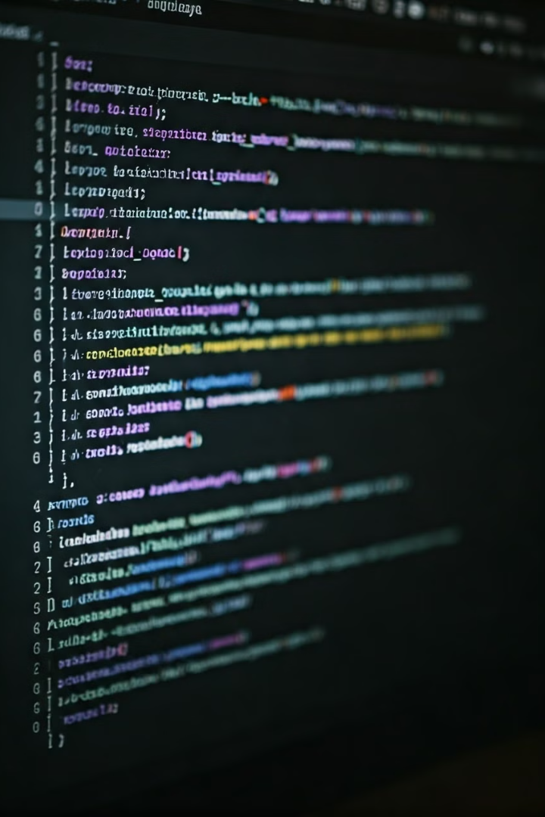
What is Python?
Python is a high-level, interpreted programming language.
Known for its simplicity and readability.
Features:
Easy to learn with a simple syntax.
Extensive library support.
Cross-platform (works on Windows, macOS, Linux).
Used in web development, data analysis, artificial intelligence, and more.

Slide 4
Why Python Instead of R?
Python
R
Python is more general-purpose.
R is specialized in statistical analysis.
Python is used in web development, automation, and data science.
R is limited to data analysis.
Python has a larger user base and community support.
R has a less user base and community support.
Python has versatile libraries like NumPy, Pandas, TensorFlow.
R is strong in statistical libraries.

Slide 5

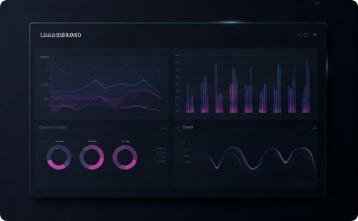
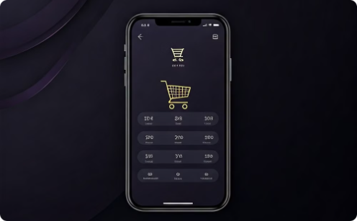
Python Apps and Websites
Web Applications
Data Analysis Tools
Mobile Apps
Use Cases:
Use Cases:
Use Cases:
Instagram: Uses Python to handle millions of users every day.
Spotify: Uses Python to analyze user data and recommend songs.
Uber: Relies on Python for backend services to efficiently match drivers and riders.
Pinterest: Manages huge amounts of user data using Python.
YouTube: Analyzes video and user data to suggest videos you might like.
Why Python?: Python is flexible and works well for the backend of mobile apps, supporting smooth performance and scalability.
Why Python?: It’s easy to build and scale websites with Python’s web frameworks like Django and Flask.
Why Python?: Python has powerful tools for handling and visualizing data, such as Pandas and NumPy.

Slide 6
Python Data Types
1
Integers (int)
Integers are whole numbers, without any decimal points. They can be positive, negative, or zero. Examples include 5, -10, and 0.
2
Floats
Floats represent real numbers, which can have decimal points. They are used to represent numbers with fractional parts. Examples include 3.14, -2.5, and 0.001.
3
String
Strings are sequences of characters, like "Hello" and "Python." They are used to store and manipulate text, creating messages and labels.

Slide 7
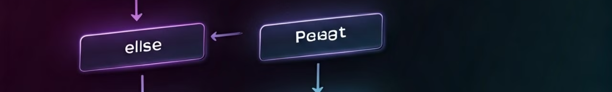


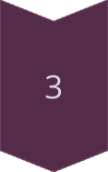
Conditional Statements: If-Else
The `if` Statement
The `if` statement checks a condition. If the condition is true, the code block inside the `if` statement is executed.
The `else` Statement
The `else` statement provides an alternative code block to be executed if the `if` statement's condition is false.
The `elif` Statement
The `elif` statement (short for "else if") can be used to check additional conditions if the previous `if` or `elif` conditions are false.

Slide 8

Loops: For and While
For Loops
1
For loops are used to iterate over a sequence of items, such as a list, tuple, or string. It executes the code block within the loop for each item in the sequence.
2
While Loops
Example Code
While loops execute a code block repeatedly as long as a certain condition remains true. The condition is checked at the beginning of each iteration, and the loop continues until the condition becomes false.
For i in range(5):
print(i)
Example Code
# Output: 0, 1, 2, 3, 4
i = 0
while i < 5:
print(i)
i += 1
# Output: 0, 1, 2, 3, 4

Slide 9

Data Structures: Lists, Sets, and Tuples
Features
List
Set
Tuple
Definition
Ordered, mutable collection
Unordered, mutable collection of unique items
Ordered, immutable collection
Syntax
my_list = [1, 2, 3]
my_set = {1, 2, 3}
my_tuple = (1, 2, 3)
Duplicates
Allows duplicates
Does not allow duplicates
Allows duplicates
Indexing
Supports indexing and slicing
Does not support indexing
Supports indexing and slicing

Slide 10
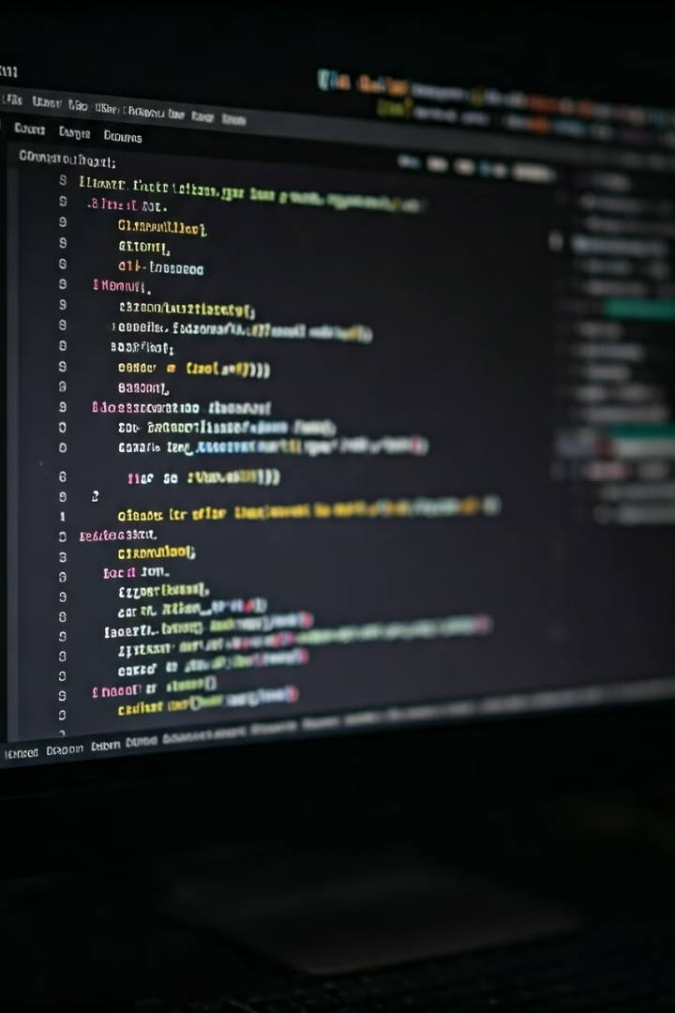
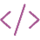



Functions: Reusable Code Blocks
What are Functions?
Functions are reusable blocks of code that perform specific tasks. They take input values (arguments), process them, and return an output value.
Benefits of Functions
Functions help to organize your code, improve readability, and promote code reusability. They make your code more modular and easier to maintain.
Defining Functions
def function_name(parameters):
# code block
Example Code
def greet(name):
print(f"Hello, {name}!")
greet("Heba")]
# Output: Hello Heba

Slide 11
Thank You

